Slide 1
Nonlinear Equations in One Variable
Lecture-1

Slide 2
Objective:
To find the root of a nonlinear equation in on variable with the help of different methods .
Methodologies:
Five methods can be used to find roots of nonlinear equation in one variable. They are-
1. Graphical Method (to find the nature of the roots)
2. Bisection Method
3. The Secant Method
4. Newton-Raphson Method
5. Fixed Point Iteration Method

Slide 3
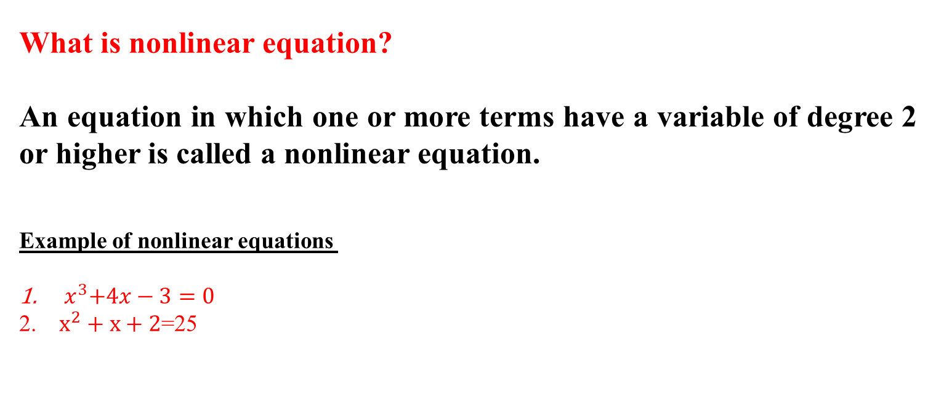
What is nonlinear equation?
An equation in which one or more terms have a variable of degree 2 or higher is called a nonlinear equation.
Example of nonlinear equations
${ x}^{3}+4x−3=0$
$x^{2}+x+2$=25

Slide 4
Number of Real Roots by Graphical Method
of degree n has exactly n roots.
A polynomial equation
Some of them are real and others are complex.
Geometrically, if the graph of crosses the x-axis at x = a , then x = a is a real root of
Now we shall consider graphically to find the number of real roots and its location.

Slide 5
Rewrite the equation as
At the point of intersection (say) of the graphs and
that is and hence is a root of the equation.
Thus the number of intersections of the two graphs will be the number of real roots (See the following figure)

Slide 6
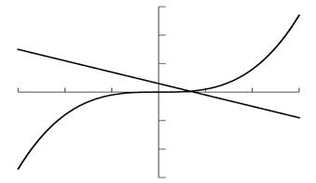

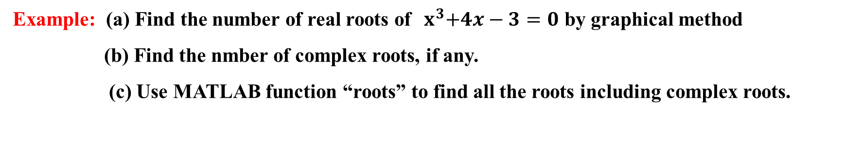
Example: (a) Find the number of real roots of${ x}^{3}+4x−3=0$ by graphical method (b) Find the nmber of complex roots, if any. (c) Use MATLAB function “roots” to find all the roots including complex roots.
Problems and Solutions
$\left(a\right){ x}^{3}+4x−3=$0
$⟹x^{3}=3−4x$
Let, $f_{1}\left(x\right)=x^{3}$ and $f_{2}\left(x\right)=3−4x$
There is one point of intersection here in the plot. So the number of real root is 1

Slide 7
(b) It is a polynomial equation of degree three and hence the total number of roots is three. So, number of complex roots = Total number of roots - Number of real roots =3-1=2.
(c) >> p=[1 0 4 -3] % entry of cubic polynomial
p = 1 0 4 -3
>> Roots = roots(p)
Roots =
-0.3368 + 2.0833i
-0.3368 - 2.0833i
0.6736 + 0.0000i

Slide 8
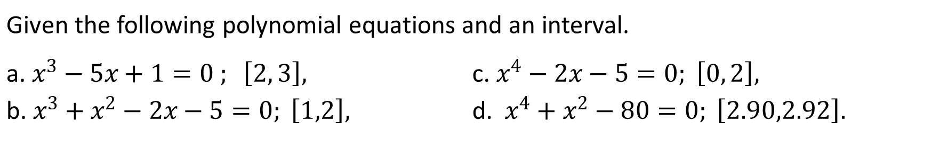
Exercise
Given the following polynomial equations and an interval.
a. $x^{3}−5x+1=0 ; \left[2, 3\right],$ b. $x^{3}+x^{2}−2x−5=0; \left[1,2\right],$ | c. $x^{4}−2x−5=0; \left[0, 2\right],$ d. $x^{4}+x^{2}−80=0; \left[2.90,2.92\right].$
Find the number of real roots of the equation by graphical method. Find also the number of complex roots, if any. Write MATLAB commands “roots” to find all the roots including complex roots.

Slide 9
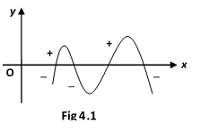
Location of Roots
To locate the roots of first study the graph of as shown below (Fig-4.1) .
If we can find two values of x, one for which is positive, and one for which is negative,
then the curve must have crossed the x-axis and so must have passed through a root of the equation
In general, if is continuous in and and are opposite in signs i.e.,
, then there exists odd number of real roots (at least one root) of in
But the only exception where it does not work is when curve touches the x-axis. For this case, the existence of a root can be determined by the sign of in the interval containing the root and it will satisfy the condition

Slide 10
Example:
The equation has two real roots. For each root, find an interval where it lies.
Solution: Consider the values of function for different values of x:
x | f(x)
-2 | 1.59
-1 | 0.26
0 | -1
1 | -1
2 | 5.39
From the above table, we see that $f\left(−1\right)f\left(0\right)=−0.26<0$, a root lies in $\left(−1, 0\right),$
and $f\left(1\right)f\left(2\right)=−5.39<0$, a root lies in $(1,2)$

Slide 11
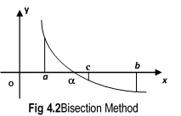
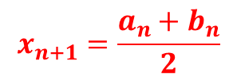
.
Techniques to find real roots
Method of Bisection
Algorithm:
Step-1: If be continuous in , Choose two approximations a and b such that .
Step-2: Evaluate the mid-point c of such that
Step-3: If we conclude that c is a root of .If and
If the root is in or
(ii) If the root is in
By designating the new interval of root as
we can calculate the next iterate
Step-4:
$$x_{n+1}=\frac{a_{n}+b_{n}}{2}$$
by the formula
, n = 1, 2, 3, . . .
Step-5:
Repeat the process until
,where
is the specified accuracy

Slide 12
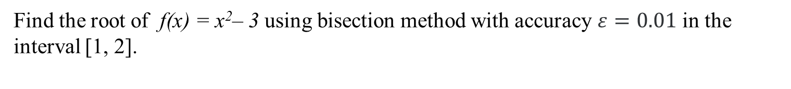
Problems and Solutions
Example:
Find the root of f(x) = x²– 3 using bisection method with accuracy $ε=0.01$ in the interval [1, 2].
Solution:
A | b | f(a) | f(b) | c = (a + b)/2 | f(c) | f(a)*f(c) | Update | b − a
1.0 | 2.0 | -2.0 | 1.0 | 1.5 | -0.75 | > 0 | a = c | 0.5
1.5 | 2.0 | -0.75 | 1.0 | 1.75 | 0.062 | < 0 | b = c | 0.25
1.5 | 1.75 | -0.75 | 0.0625 | 1.625 | -0.359 | > 0 | a = c | 0.125
1.625 | 1.75 | -0.3594 | 0.0625 | 1.6875 | -0.1523 | > 0 | a = c | 0.0625
1.6875 | 1.75 | -0.1523 | 0.0625 | 1.7188 | -0.0457 | > 0 | a = c | 0.0313
1.7188 | 1.75 | -0.0457 | 0.0625 | 1.7344 | 0.0081 | < 0 | b = c | 0.0156
1.71988 | 1.7344 | -0.0457 | 0.0081 | 1.7266 | -0.0189 | > 0 | a = c | 0.0078

Slide 13
Exercise
Given the following polynomial equations and an interval.
a. $x^{3}−5x+1=0 ; \left[2, 3\right],$ b. $x^{3}+x^{2}−2x−5=0; \left[1,2\right],$ | c. $x^{4}−2x−5=0; \left[0, 2\right],$ d. $x^{4}+x^{2}−80=0; \left[2.90,2.92\right].$
Apply bisection method two times in the given interval to find the new smaller interval of this root.

Slide 14
Advantages and Drawbacks: Bisection Method
Advantages:
Always Convergent.
Drawbacks:
Slow convergence.
If one of the initial guess is closer to the root , the convergence is slower.

Slide 15
Outcome
By applying Bisection method, nonlinear equations in one variable can be solved to find roots (approximately), although it has few drawbacks.

Slide 16



Multiple Choice Questions
1. Find the degree of the polynomial
$$x^{4}+x^{2}−80=0.$$
a) 3 , b) 2 , c) 4 , d) 5
2. Find the number of real roots of the polynomial
$$x^{3}+x^{2}−2x−5=0.$$
a) 3 , b) 1 , c) 4 , d) 5
3. Find the number of complex roots of the polynomial
$$x^{4}+x^{2}−80=0$$
a) 3 , b) 2 , c) 4 , d) 5
4. If
${f\left(x\right)=x}^{3}−5x+1=0 is continuous on the interval \left[2, 3\right],$ What is the value of $f\left(2\right)?$
a) -3 , b) -1 , c) 4 , d) 0

Slide 17


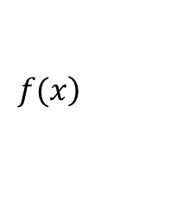


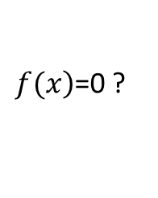
5. If is continuous in then what is the condition that there exists odd number of real roots(at least one root) of
$$\left.f(x\right)$$
$$\left[a, b\right]$$
$\left.f(x\right)$=0 ?
a) , b) , c) ,d) Neither
$$f(a)f(b)<0$$
$$f\left(a\right)f\left(b\right)>0$$
$$f(a)<0$$

